Slide 1

Parvatibai Genba Moze College of engineering, Wagholi,Pune Department of Computer Engineering Presentation on Seminar topic entitled Blockchain in E-Voting System Presented By: Shubhangi Dhobale. Guided By: Prof. Shrikant Dhamdhere.

Slide 2
Contents
Introduction to Blockchain
Goals and objective
Scope
Literature Survey
Blockchain Creation
Features of Blockchain
Working of Blockchain
Existing Voting System and its Disadvantages
Proposed Voting System
Election Roles and Process
Design and Implementation
Architecture of Voting System
Use Case Diagram
Conclusion
References

Slide 3
Introduction of Blockchain
The term “BLOCKCHAIN” refere to the way BC stores transaction data in “Blocks”.
They are linked to form a chain.
The chain grows as the number of transaction increases.
Every entry in a blockchain is stored as block on a chain.
Blockchain is a distributed system recording and storing transaction records.
In a Blockchain system, there is no central authority.
Blockchain is immutable, i.e., data cannot be deleted.
Blockchain are secure.
Data can be distributed but cannot be copied.

Slide 4
Goals and Objective
To achieve high security using Blockchain.
To develop trust factor in voting system.
To achieve transparency in system by tracking all activities.
To implement decentralized system so that data is stord in multiple systems.
Scope
Using blockchain technology, we can make sure that those who are voting are who they say they are and are legally allowed to vote. Plus, by using blockchain technology, anyone who knows how to use a cell phone can understand the technology required for voting.
Using the blockchain for voting ensures a necessary level of transparency. The chief benefit of switching our voting systems over to the blockchain is the enhanced level of transparency the blockchain allows for.
The blockchain would definitively preclude bad actors from cheating the system. It would make sure people do not vote twice, since we have an immutable record of their vote and their identity. And no one would ever be able to delete votes, because, again, the blockchain is immutable. Those charged with counting votes would have a final record of every vote counted that could be checked by regulators or auditors at any time.

Slide 5
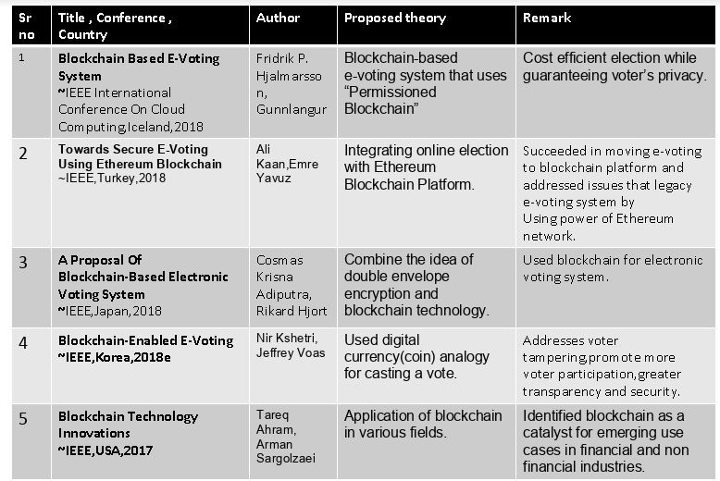
Literature Survey

Slide 6
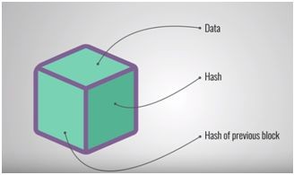
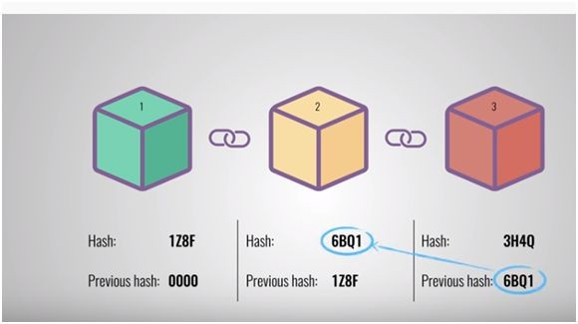
Blockchain Creation
Every block has data, hash of the block and hash of previous block. When new block is created then hash of previous block is stored in this block and then hash of new block is calculated and store in it. In this way blockchain is created.
Fig: Block Representation Fig: Blockchain Creation

Slide 7
Features of Blockchain
Large Capacity: The network’s capacity can be increased limitlessly by increasing the number of computers.
Best Security: Every transaction is highly secured by the nodes on the network.
Transparency: Every transaction on the blockchain is visible.
Immutability: Data once added can neither be changed.
Decentralization: There is no governing authority or a single person looking after the network.
Faster Settlement: Blockchain offers a faster settlement of funds as compared to other traditional banking systems.
Synchronized: Every participants are accessing exactly the same data.
Privacy: Data is encrypted such that only authorized person can access the data against which they have permissions.

Slide 8
Working of blockchain
Blockchain technology was first used within Bitcoin and is a public ledger of all transactions. A blockchain stores these transactions in a block, the block eventually becomes completed as more transactions are carried out. Once complete it is then added in a linear, chronological order to the blockchain.
The initial block in a blockchain is known as the ‘Genesis block’ or ‘Block 0’. The genesis block is usually hardcoded into the software; it is special in that it doesn’t contain a reference to a previous block. (‘Genesis Block’, 2015) Once the genesis block has been initialised ‘Block 1’ is created and when complete is attached to the genesis block. Each block has a transaction data part, copies
of each transaction are hashed, and then the hashes are paired and hashed again, this continues until a single hash remains; also known as a merkle root .

Slide 9
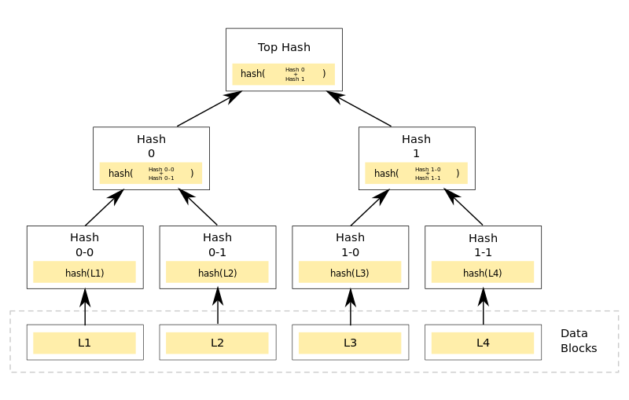
Working of Blockchain

Slide 10
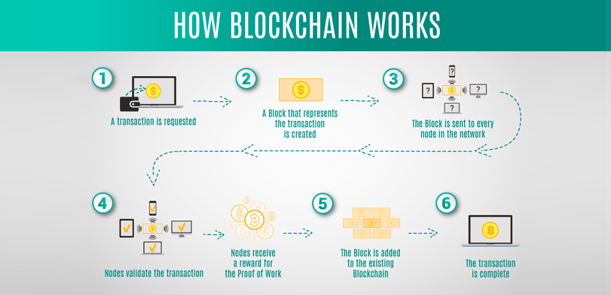
Working of Blockchain

Slide 11
Existing Voting System
Electronic Voting Machines (&quot;EVM&quot;) are being used in Indian General and state elections to implement electronic voting in part from 1999 elections and recently in 2019 Vidhan Sabha Elections.
Before EVM, vote counting was done by paper ballot but with the advancement in technology, electronic voting machines came into the picture. EVMs have replaced paper ballots in local,state and general elections in india.
There are two units in EVM : the control unit and the balloting unit. These units are joined together with the help of cable.
The control unit of the EVM is kept with the presiding officer or the polling officer.
The balloting unit is kept within the voting compartment for electors to cast their votes. This helps polling officer to verify your identity
With the EVM, instead of issuing a ballot paper, the polling officer will press the Ballot Button which enables the voter to cast their vote.

Slide 12
Disdavantages of Existing voting system
Vulnerability to hacking.
Susceptibility to fraud
Malicious programming.
The time gap between the voting and counting of votes is large which leads to tampering.
Due to the physical accessibility to the EVM, the third party can interrupt and change the count of votes.

Slide 13
Proposed System
Proposed system is an internet voting system . We provide an online platform for voting i.e a website. Propose system three parts as Voter, Election Administrator and Election Process.
Voter : Voter is the main part of the system which participate in the election process. He register himself in system by giving his personal information.
Election Administrator : To manage all the data coming from voter during registration.
and election process, election administrator has worked. Also it generate public and private keys for voters. It is nothing but python packages.
Election Process : In this process voter select the candidate to vote and give his vote for selected candidate.

Slide 14
Working of Proposed System
In proposed system as told earlier voter register himself. During registration system takes voter’s unique identity number. Unique identity is for generating unique public and private key for every voter. So here problem of double voting is solved. After taking all required information from voter, if the voter is eligible for voting process then only system accept registration of voters. Then system i.e election administrator generate public and private keys for voter.
Public and Private Key
Private key and public key are the hash value data which is unreadable. During election process for login purpose and giving vote to candidate public key and private key is required. It acts like login id and password in this voting process. But voter cannot always remember it as it is large value. After successful registration this keys send to the registered email or mobile number. Also during voting process for data encryption and decryption purpose it is used

Slide 15
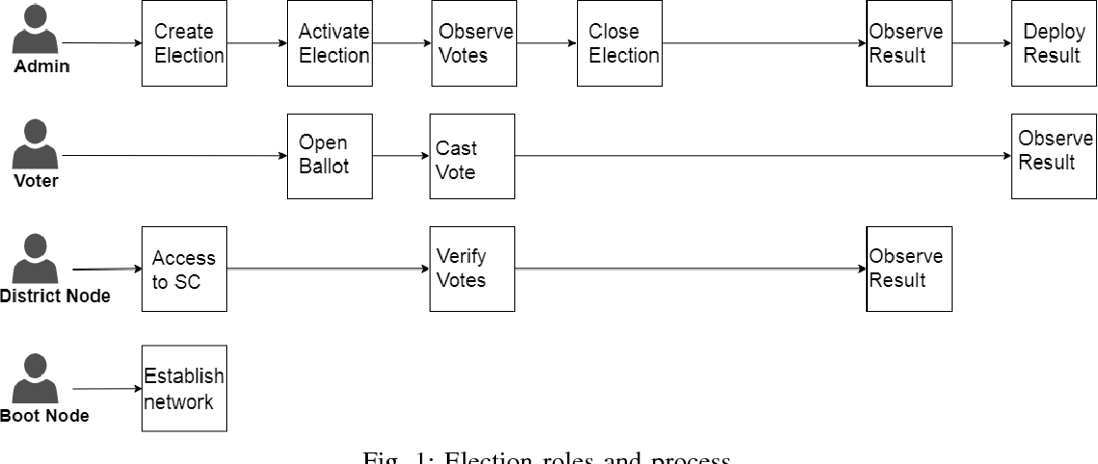
Election Roles and Process

Slide 16
Election Roles and Process
Election Roles:
As can be seen in Figure 1, elections in our proposal enable participation of individuals or institutions in the following roles. Where multiple institutions and individuals can be enrolled to the same role.
(i) Election administrators: Manage the lifecycle of an election. Multiple trusted institutions and companies are enrolled with this role. The election administrators specify the election type and create aforementioned election, conﬁgurate ballots, register voters, decide the lifetime of the election and assign permissioned nodes.
(ii) Voters: For elections to which they are eligible for, voters can authenticate themselves, load election ballots, cast their vote and verify their vote after an election is over. Voters can be rewarded for voting with tokens when they cast their vote in an election in the near future, which could be integrated with a smart city project.

Slide 17
Election Roles and Process
(iii) District nodes: When the election administrators create an election, each ballot smart contracts, representing each voting district, are deployed onto the blockchain. When the ballot smart contracts are created, each of the corresponding district nodes are given permission to interact with their corresponding ballot smart contract. When an individual voter casts his vote from his corresponding smart contract, the vote data is veriﬁed by all of the corresponding district nodes and every vote they agree on are appended onto the blockchain when block time has been reached.
(iv) Bootnodes: Each institution, with permissioned access to the network, host a bootnode. A bootnode helps the district nodes to discover each other and communicate. The bootnodes do not keep any state of the blockchain and is ran on a static IP so that district nodes ﬁnd its peers faster.

Slide 18
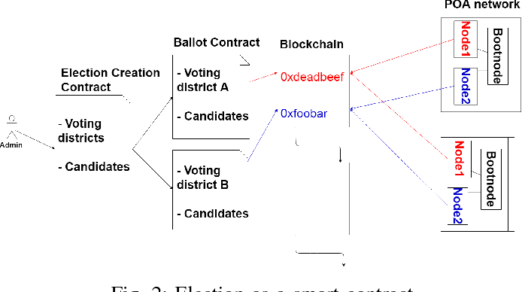
Election Roles and Process
Election Process:
In our work, each election process is represented by a set of smart contracts, which are instantiated on the blockchain by the election administrators. A smart contract is deﬁned for each of the voting districts of the election so multiple smart contracts are involved in an election. For each voter with its corresponding voting district location, deﬁned in the voters registration phase, the smart contract with the corresponding location will be prompted to the voter after the user authenticates himself when voting.

Slide 19
Design and Implemantation
To introduce a method of secure authentication, our proposed system is designed to use electronic ID authentication via Auokenni, which is an Icelandic service provider for identity veriﬁcation. Auokenni utilizes the Nexus software and RFID scanners.
When a user registers for an electronic ID, a user chooses a PIN number for its corresponding ID consisting of 6 numbers. A user will therefore identify himself in the voting booth by scanning his ID and providing his corresponding PIN number to authenticate himself to the system.
1) Any computer in any voting district can be used by any eligible voter to vote, since the wallet for the corresponding voter has information on which voting district the voter is supposed to vote from. For a user to successfully authenticate, a valid ID and PIN number needs to be presented at a voting district using a card reader and the nexus software.

Slide 20
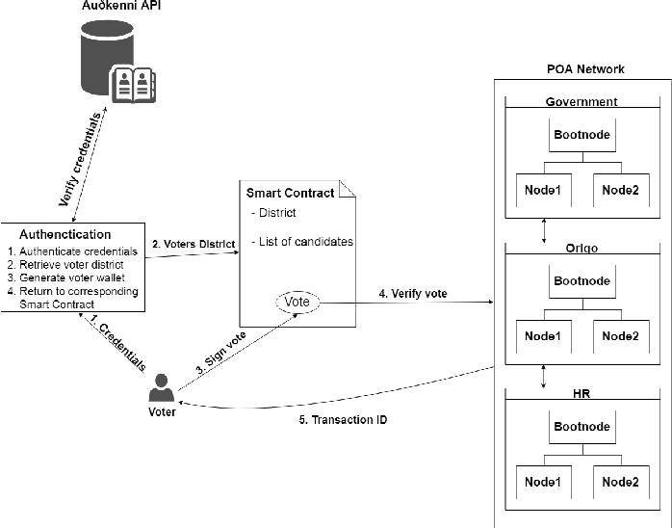
Voter Authentication Process

Slide 21
2) If the authentication is successful, the corresponding smart contract is prompted for the ongoing election. The ballot for the aforementioned election is a smart contract which has a list of the candidates a voter can choose from. 3) When a voter has selected a candidate and casts his vote, the voter proceeds to sign his vote by re-entering the corresponding PIN number for his electronic ID.
4) After the voter has signed his vote, the vote data proceeds to be veriﬁed by the corresponding district node, which the voter is interacting with the smart contract through. If the aforementioned district node accepts the vote data, the vote data must be agreed upon by the majority corresponding district node.
5) If the majority of district nodes agree upon the vote data, consensus for the particular vote has been reached. The user then receives the transaction ID for the corresponding transaction of his vote in the form of a QR-code and the option to print the transaction ID. When the vote is casted and has been veriﬁed, a function in the smart contract adds one vote to the party which was voted for. This functionality of the smart contract structure is utilized to determine the election result in each of the voting districts. Figure 3 is a visual representation of the steps we just ellaborated.
6) All transactions which were received and veriﬁed in the ongoing block time are deployed onto the blockchain after the block time has reached its time limit With each new block added to the blockchain, each district node updates his copy of the ledger.

Slide 22
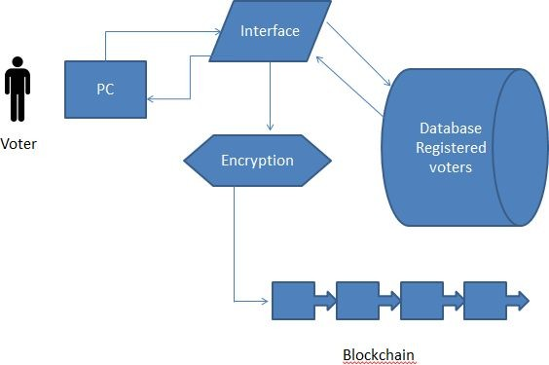
Architecture of Voting System
When determining on the architecture we took powerful inspiration from both the distributed and acquirability of the Bitcoin network and the gathering process of traditional voting. The network is a multi-tiered, decentralised infrastructure which having the two definite blockchains, the net- work is split into three abstract tiers, National, Constituency and Local. The local tier contains all the digital polling stations all over the country, each of which is connected to a constituency node. A local node is setup to only be in contact with the other local nodes under the connected constituency node and the constituency node itself.
Fig: E-Voting System Architecture

Slide 23
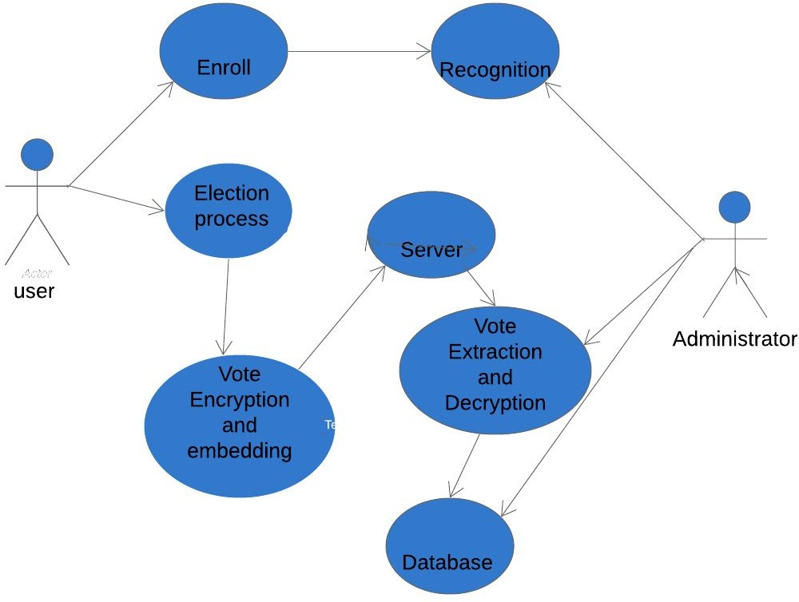
Use Case Diagram
User Profile:
Voter: User register itself in the system. If user registered successfully he has right to vote.
Administrator: It is python packages which help to generate public and private key
Candidate: He stand for election.
Use Case View:
Fig:Use case diagram

Slide 24
Conclusion
Blockchain Technology is gaining popularity day by day. Using blockchain in voting system will help to achieve secure and cost-efficient election while guaranteeing voter’s privacy. Also, due to the encryption mechanism, it is impossible for any person to gain access to all the votes without first taking control of the entire service network.
The idea of adapting digital voting systems to make the public electoral process cheaper, faster and easier, is a compelling one in modern society. Making the electoral process cheap and quick, normalizes it in the eyes of the voters, removes a certain power barrier between the voter and the elected ofﬁcial and puts a certain amount of pressure on the elected ofﬁcial. It also opens the door for a more direct form of democracy, allowing voters to express their will on individual bills and propositions.

Slide 25
References
[1] Agora (2017). Agora: Bringing our voting systems into the 21st century Available at: https://agora.vote/Agora_Whitepaper_v0.1.pdf
[2] Kirill Nikitin, Kokoris-Kogias, Philipp Jovanovic, Linus Gasser, Nicolas Gailly, Ismail Khofﬁ, Justin Cappos and Bryan Ford (2017). CHAINIAC: Proactive Software-Update Transparency via Collectively Signed Skipchains and Veriﬁed Builds Available at: https://www.usenix. org/system/ﬁles/conference/usenixsecurity17/sec17-nikitin.pdf
[3] Alin Tomescu and Srinivas Devadas(2017). Catena: Efﬁcient Nonequivocation via Bitcoin Available at: https://people.csail.mit.edu/ alinush/papers/catena-sp2017.pdf
[4] Michael del Castillo (2018). Sierra Leone Secretly Holds First Blockchain-Audited Presidential Vote Available at: https://www.coindesk.com/ sierra-leone-secretly-holds-ﬁrst-blockchain-powered-presidential-vote/
[5] Ethereum Blog. (2018). On Public and Private Blockchains Ethereum Blog. Available at: https://blog.ethereum.org/2015/08/07/ on-public-and-private-blockchains/

Slide 26
Thank You!!!

